Slide 1
DABT Study Group
Recert Exam 2015 Part B V1
Questions 9-16

Slide 2
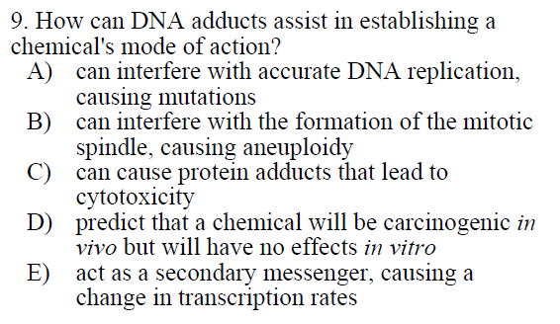

Slide 3
A) Best answer (p. 137 Essentials, Genetic Tox Chapter)
B) Aneuploidy = abnormal # of chromosomes (X-rays, colchicine, benzene, etc…)
C) DNA adducts won’t lead to protein adducts
D) DNA adducts can affect cells in vivo or in vitro studies
E) Not associated with DNA adducts – Second messengers are released in a cell usually promoted by a hormone (Wiki)

Slide 4
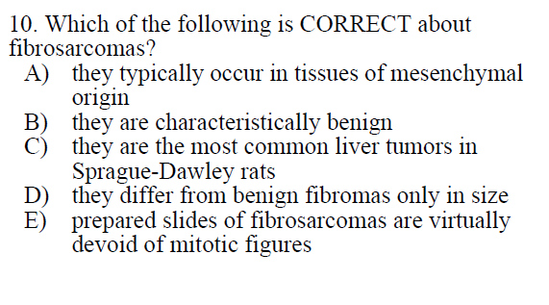

Slide 5
A) best answer: malignant mesenchymal tumor derived from fibrous connective tissue (Wiki; p 122 Essentials; Chemical Carcinogeneis)
Eliminate B, C
“numerous atyipical mitoses” (Wiki)
Eliminate E
C) Would it be hepatocellular adenoma? Could not find much info.
D) Eliminate: benign vs. malignant = other differences
Malignant tumors capable of metastasis, invasion

Slide 6
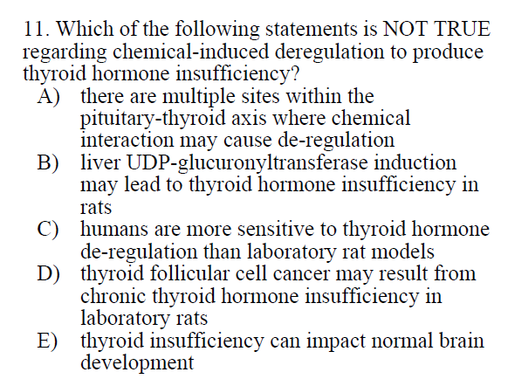

Slide 7
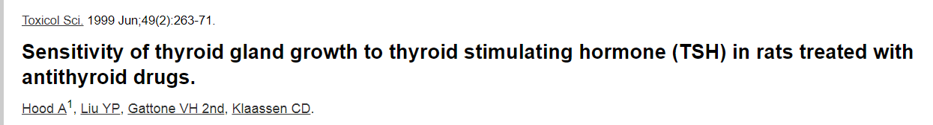
A,B, E are true Ch. 21 C&D
C is False
Rats are more sensitive to thyroid hormone de-regulation than humans; rodent chronic hypersecretion of TSH results in focal hyperplasia and neoplastic lesions
D is true (see article below)

Slide 8
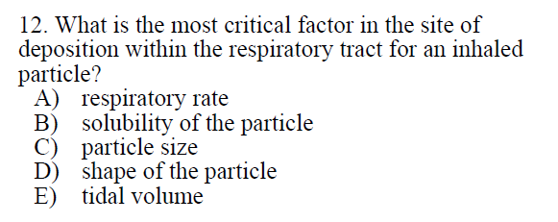

Slide 9
See C&D Chapter 15

Slide 10
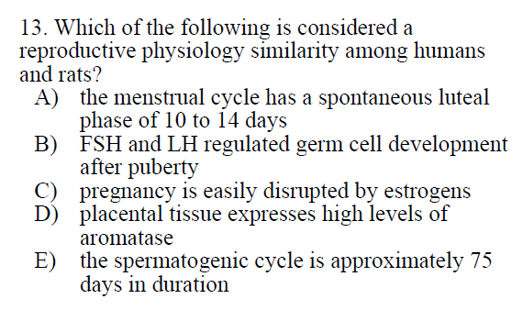

Slide 11
A) luteal phase is mating induced in rats
B) Correct
C) Rats only
D)Aromatase not expressed in rat placental tissue
E) Spermatogenic cycle is ~53 days in rats
See C&D Ch 20 (Table 20-2 in 8th Ed.)

Slide 12
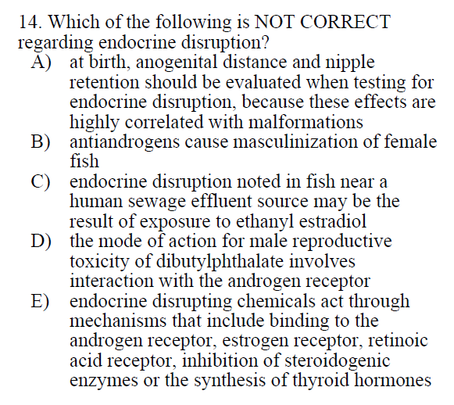

Slide 13
A) True: C&D 8th Ed. Ch 10 p. 503
B) false – Androgens cause masculinization of female fish (C&D 7th ed. Ch. 20 p. 789)
Androgens stimulate/control male characteristics (testosterone)
Antiandrogen effects most likely in males: hypospadias, retained nipples, etc… (ex. Dibutylphthalate)
C) True: Ch 20
D) may not be absolutely correct: not direct interaction, C&D 8th Ed. Ch 10 p. 502)
E) True: Ch 10

Slide 14
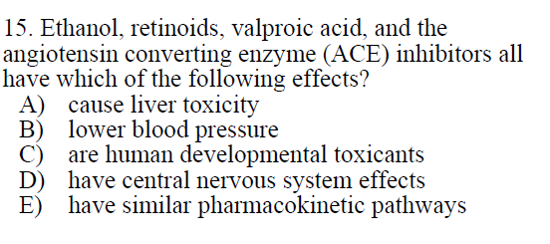

Slide 15
C is correct answer
Essentials p. 150, Chapter 10 Developmental Toxicology

Slide 16
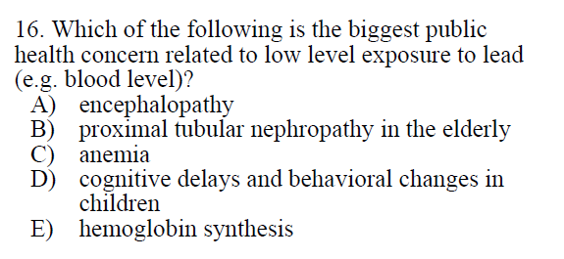

Slide 17
A) Adults: 80-100 µg/dL; Children: 100-120 µg/dL
B) Adults: 40 µg/dL; Children: 40-60 µg/dL
C) Adults/Children: 80-100 µg/dL
D is correct; 5-35 µg/dL → 2-4 point IQ deficit for each µg/dL increase
Essentials p. 352; Ch 23 Toxic Effects of Metals
E) Inhibition of δ-aminolevulinic acid dehydratase (ALAD) and ferrochelase
Adults/Children: 10 µg/dL

